Slide 1
LMEDS: A Platform for Collecting Prosodic Annotations Online
Tim Mahrt Aix Marseille Université, CNRS, LPL UMR 7309, 13100, Aix-en-Provence, France
Universität zu Köln - Institut für Linguistik Abteilung Phonetik Colloquium
04-25-2016

Slide 2
Overview
Rapid Prosody Transcription (RPT)
Language Markup and Experimental Design Software (LMEDS)
RPT online with LMEDS
Setting up an LMEDS experiment
Comparing RPT annotations
Internet-based vs Laboratory-based
Annotations gathered under different instructions

Slide 3
Rapid Prosody Transcription

Slide 4
What is RPT?
Prosodic annotation system
Listeners mark up the boundaries and prominences they hear on a transcript
Real time

Slide 5
RPT method
The annotator listens to speech sample of up to 1 minute duration, and follows along on a printed transcript with no punctuation or capitalization.
Round 1: boundaries | Select the location of boundaries that separate perceived chunks of speech:
 | …it’s gonna happen that our society…

Slide 6
RPT method
The annotator listens to speech sample of up to 1 minute duration, and follows along on a printed transcript with no punctuation or capitalization.
Round 1: boundaries | Select the location of boundaries that separate perceived chunks of speech:
 | …it’s gonna happen that our society…
Round 2: prominences | Selects words perceived as prominent:
 | …it’s gonna happen that our society…

Slide 7
Coding and pooling data
Each annotator’s annotations are coded on each word as a 0 or 1 for Prominence, and 0 or 1 for Boundary.
Annotations are pooled over annotators

Slide 8
 |  |  |  | Boundary |  |  |  | Prominence
Token | word | B-score | P-score | A1 | A2 | A3 | A4 | A5 | A6 | A7 | A8 | …
1 | i | 0 | 0 | 0 | 0 | 0 | 0 | 0 | 0 | 0 | 0
2 | really | 0 | 0.56 | 0 | 0 | 0 | 0 | 0 | 1 | 1 | 0
3 | don't | 0 | 0.25 | 0 | 0 | 0 | 0 | 0 | 0 | 0 | 0
4 | know | 0.81 | 0.44 | 1 | 1 | 1 | 0 | 0 | 0 | 0 | 0
5 | i | 0 | 0 | 0 | 0 | 0 | 0 | 0 | 0 | 0 | 0
6 | think | 0.31 | 0.44 | 0 | 0 | 0 | 0 | 0 | 1 | 0 | 0
7 | in | 0 | 0 | 0 | 0 | 0 | 0 | 0 | 0 | 0 | 0
8 | today's | 0 | 0.81 | 0 | 0 | 0 | 0 | 1 | 1 | 0 | 0
9 | world | 0.81 | 0.44 | 1 | 1 | 1 | 0 | 0 | 0 | 0 | 0
10 | what | 0 | 0 | 0 | 0 | 0 | 0 | 0 | 0 | 0 | 0
11 | they | 0 | 0 | 0 | 0 | 0 | 0 | 0 | 0 | 0 | 0
12 | call | 0 | 0 | 0 | 0 | 0 | 0 | 0 | 0 | 0 | 0
13 | the | 0 | 0 | 0 | 0 | 0 | 0 | 0 | 0 | 0 | 0
14 | nineties | 0.81 | 0.5 | 1 | 1 | 1 | 0 | 1 | 0 | 0 | 1
15 | that | 0.5 | 0.13 | 0 | 1 | 1 | 0 | 0 | 0 | 0 | 0
16 | uh | 0.38 | 0 | 1 | 0 | 0 | 0 | 0 | 0 | 0 | 0
17 | it's | 0 | 0 | 0 | 0 | 0 | 0 | 0 | 0 | 0 | 0
19 | like | 0 | 0.06 | 0 | 0 | 0 | 0 | 0 | 0 | 0 | 0

Slide 9
 |  |  |  | Boundary |  |  |  | Prominence
Token | word | B-score | P-score | A1 | A2 | A3 | A4 | A1 | A2 | A3 | A4 | …
1 | i | 0 | 0 | 0 | 0 | 0 | 0 | 0 | 0 | 0 | 0
2 | really | 0 | 0.56 | 0 | 0 | 0 | 0 | 0 | 1 | 1 | 0
3 | don't | 0 | 0.25 | 0 | 0 | 0 | 0 | 0 | 0 | 0 | 0
4 | know | 0.81 | 0.44 | 1 | 1 | 1 | 0 | 0 | 0 | 0 | 0
5 | i | 0 | 0 | 0 | 0 | 0 | 0 | 0 | 0 | 0 | 0
6 | think | 0.31 | 0.44 | 0 | 0 | 0 | 0 | 0 | 1 | 0 | 0
7 | in | 0 | 0 | 0 | 0 | 0 | 0 | 0 | 0 | 0 | 0
8 | today's | 0 | 0.81 | 0 | 0 | 0 | 0 | 1 | 1 | 0 | 0
9 | world | 0.81 | 0.44 | 1 | 1 | 1 | 0 | 0 | 0 | 0 | 0
10 | what | 0 | 0 | 0 | 0 | 0 | 0 | 0 | 0 | 0 | 0
11 | they | 0 | 0 | 0 | 0 | 0 | 0 | 0 | 0 | 0 | 0
12 | call | 0 | 0 | 0 | 0 | 0 | 0 | 0 | 0 | 0 | 0
13 | the | 0 | 0 | 0 | 0 | 0 | 0 | 0 | 0 | 0 | 0
14 | nineties | 0.81 | 0.5 | 1 | 1 | 1 | 0 | 1 | 0 | 0 | 1
15 | that | 0.5 | 0.13 | 0 | 1 | 1 | 0 | 0 | 0 | 0 | 0
16 | uh | 0.38 | 0 | 1 | 0 | 0 | 0 | 0 | 0 | 0 | 0
17 | it's | 0 | 0 | 0 | 0 | 0 | 0 | 0 | 0 | 0 | 0
19 | like | 0 | 0.06 | 0 | 0 | 0 | 0 | 0 | 0 | 0 | 0
1 annotator’s labels

Slide 10
 |  |  |  | Boundary |  |  |  | Prominence
Token | word | B-score | P-score | A1 | A2 | A3 | A4 | A1 | A2 | A3 | A4 | …
1 | i | 0 | 0 | 0 | 0 | 0 | 0 | 0 | 0 | 0 | 0
2 | really | 0 | 0.56 | 0 | 0 | 0 | 0 | 0 | 1 | 1 | 0
3 | don't | 0 | 0.25 | 0 | 0 | 0 | 0 | 0 | 0 | 0 | 0
4 | know | 0.81 | 0.44 | 1 | 1 | 1 | 0 | 0 | 0 | 0 | 0
5 | i | 0 | 0 | 0 | 0 | 0 | 0 | 0 | 0 | 0 | 0
6 | think | 0.31 | 0.44 | 0 | 0 | 0 | 0 | 0 | 1 | 0 | 0
7 | in | 0 | 0 | 0 | 0 | 0 | 0 | 0 | 0 | 0 | 0
8 | today's | 0 | 0.81 | 0 | 0 | 0 | 0 | 1 | 1 | 0 | 0
9 | world | 0.81 | 0.44 | 1 | 1 | 1 | 0 | 0 | 0 | 0 | 0
10 | what | 0 | 0 | 0 | 0 | 0 | 0 | 0 | 0 | 0 | 0
11 | they | 0 | 0 | 0 | 0 | 0 | 0 | 0 | 0 | 0 | 0
12 | call | 0 | 0 | 0 | 0 | 0 | 0 | 0 | 0 | 0 | 0
13 | the | 0 | 0 | 0 | 0 | 0 | 0 | 0 | 0 | 0 | 0
14 | nineties | 0.81 | 0.5 | 1 | 1 | 1 | 0 | 1 | 0 | 0 | 1
15 | that | 0.5 | 0.13 | 0 | 1 | 1 | 0 | 0 | 0 | 0 | 0
16 | uh | 0.38 | 0 | 1 | 0 | 0 | 0 | 0 | 0 | 0 | 0
17 | it's | 0 | 0 | 0 | 0 | 0 | 0 | 0 | 0 | 0 | 0
19 | like | 0 | 0.06 | 0 | 0 | 0 | 0 | 0 | 0 | 0 | 0
Prominences and Boundaries coded as counts or proportions

Slide 11
Prominence scores (proportions) plotted for each word in an (partial) utterance.
Prominence Peak

Slide 12
Prominence scores (proportions) plotted for each word in an (partial) utterance.
Prominence Zeroes

Slide 13
Prominence scores (proportions) plotted for each word in an (partial) utterance.
Diffuse Prominence

Slide 14
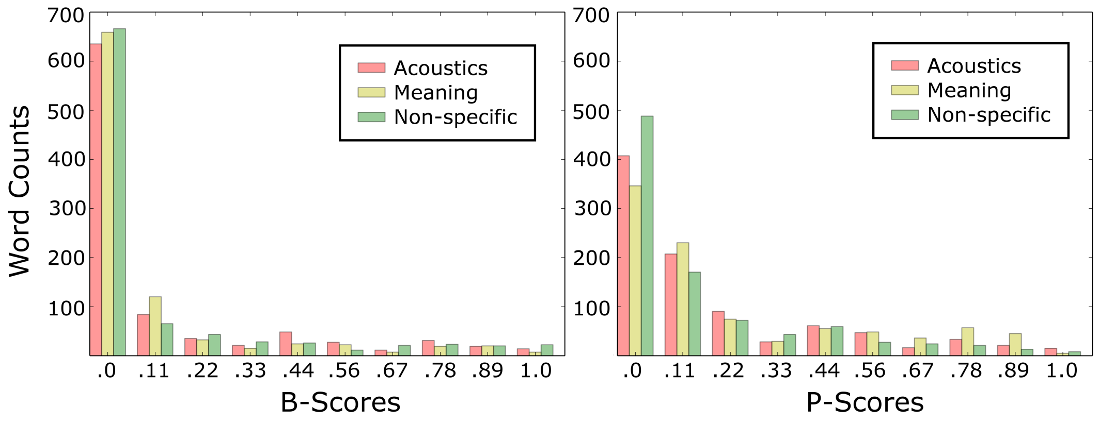
Distribution of P-Scores and B-Scores
Three different RPT experiments
(The difference isn’t important here)
Data presented in Cole, Mahrt, and Hualde Speech Prosody 2014

Slide 15
Take Away Message
Lots of zeroes (informative)
Scores of 0.1 are generally considered zero as well
Similarly low number of diffuse scores and high valued scores
Agreement in b-scores are more consistent than agreement in p-scores
Driven by a larger number of zero b-scores.

Slide 16
RPT vs Other Annotation Schemes
Compared with systems like ToBI
No training necessary
Possible to crowd source
Annotation is fast
Coarse-grained measure

Slide 17
Some Work Done with RPT
RPT has been done for a number of prosodically different languages
English
Cole, Mo, and Hasegawa-Johnson 2010
Hindi
Jyothi, Cole, Hasegawa-Johnson and Puri Speech Prosody 2014
Spanish
French
Smith 2014
And for comparing different intralanguage speech communities
Japanese EFL vs American English
Mizuguchi, Cole, Pinter, Tateishi, and Mahrt ETAP 2015
Indian English vs American English
Cole, Mahrt, and Roy ETAP 2015

Slide 18
Some Work Done with RPT
P-scores and b-scores correlate with acoustic cues to prominences and boundaries
Cole, Mo, and Beck 2010
Cole, Mo, and Hasegawa-Johnson 2010
RPT scores are sensitive to the instructions given to labelers
Cole, Mahrt, and Hualde Speech Prosody 2014
Smith 2014

Slide 19
LMEDS: Language Markup and Design Software

Slide 20
RPT With LMEDS

Slide 21
LMEDS Stats
In addition to RPT, LMEDS has been used for
AXB tasks
memory tasks
demographic surveys
cloze tests
free response

Slide 22
LMEDS Stats
LMEDS studies have been run in
U.S.A. (lab and online)
France (lab)
Spain (lab)
India (online)

Slide 23
LMEDS Stats
Over 1000 subjects have been run in LMEDS across studies
About 3/4 on Mechanical Turk
About 1/4 in a laboratory setting

Slide 24
LMEDS: Technical specification
Python code that sits on a server and generates HTML and javascript
Low dependencies: only external library is jQuery
Audio played through HTML5
LMEDS runs on any of the popular web browsers

Slide 25
Acquiring LMEDS
LMEDS is publically available open source software (no login needed): https://github.com/timmahrt/LMEDS
The official home of LMEDS can be found here:
http://prosody.beckman.illinois.edu/lmeds.html

Slide 26
Using LMEDS
Experiment specification files are plain text
Don’t require any programming experience
Stimuli, instructions, and responses can be in any language
Outputs to CSV – results can be immediately read in Excel

Slide 27
LMEDS Experiment Components
Data Files - audio
- transcripts
- images
Test Specification (Sequence file)
Dictionary File - LMEDS system messages - experiment instructions
- consent form

Slide 28
Using LMEDS
Data Files - audio
- transcripts
- images
Test Specification (Sequence file)
Dictionary File - LMEDS system messages - experiment instructions
- consent form
Multiple sequence files and language files can be used for the same set of data files.

Slide 29
Designing a new experiment in LMEDS: A TUTORIAL

Slide 30
LMEDS Contents
Fully functional demo
Sequence file
Dictionary file
User Manual
LMEDS Software
LMEDS (HTML, Python, CSS)
User scripts (tools)
Local server

Slide 31
LMEDS Contents
Fully functional demo
Sequence file
Dictionary file
User Manual
LMEDS Software
LMEDS (HTML, Python, CSS)
User scripts (tools)
Local server

Slide 32
Demo of LMEDS
http://www.timmahrt.com/lmeds.html

Slide 33
Sequence file
Each non-blank line represents one page
boundary_and_prominence wav_name transcript_name min_plays max_plays instructions_name play_audio
example
boundary_and_prominence water water 0 -1 acoustics true

Slide 34
Sequence file
Pages are iterated sequentially
No options (yet) to randomize sequence or stimuli order

Slide 35
Sequence file
*LMEDS_Demo
login
consent demo_consent
text_page presurvey_instructions
survey presurvey
text_page audio_list_instructions
audio_list 1 1 1 [water apples water]
text_page boundary_and_prominence_mechanics_instructions
text_page boundary_and_prominence_nonspecific_instructions
boundary_and_prominence apples apples 2 2 nonspecific true
text_page boundary_and_prominence_constrained_instructions
boundary apples apples 2 2 nonspecific true
prominence apples apples 2 2 nonspecific true
text_page post_survey_instructions
survey postsurvey
end

Slide 36
Dictionary file
LMEDS uses key-value pairs for text strings
The python code and sequence files specify keys
The dictionary file links the key to the text to be displayed
The experiment runner file (.cgi) specifies a dictionary to use
The same experiment can be run in different languages by using different dictionary files

Slide 37
Dictionary file
Dictionary files are split into sections marked by ‘---‘ characters of any length
These are not used by LMEDS. By convention, the section names correspond to page types (login, text_page, boundary_and_prominence)
Keywords are marked by surrounding ‘===’ characters

Slide 38
Dictionary file
------------------------------
lmeds_interface
------------------------------
====================
loading_progress
====================
Loading. Please wait.
====================
metadata_description
====================
A demonstration of the kinds of pages that can be presented to subjects via LMEDS.
====================
progress
====================
Progress

Slide 39
LMEDS Contents
Fully functional demo
User Manual
LMEDS Software
LMEDS (HTML, Python, CSS)
User scripts (tools)
Local server

Slide 40
User Manual
Have any questions about LMEDS?
Read the manual first!
Provides details about:
how to administer an experiment
the syntax, keywords, and commands used by LMEDS and LMEDS files
troubleshooting issues

Slide 41
LMEDS Contents
Fully functional demo
User Manual
LMEDS Software
LMEDS (HTML, Python, CSS)
User scripts (tools)
Local server

Slide 42
Core LMEDS Code
Won’t need to interact with
unless you want to extend LMEDS functionality
Server side code is in python
Client side code is in javascript
HTML templates and CSS for webpages
LaTeX for the user manual

Slide 43
User scripts
Command-line tools
Future plans to make them more user friendly via web interface
Located in /lmeds/user_scripts

Slide 44
Pre-processing tools
generate_language_dictionary.py
generates or updates a language dictionary, given a sequence file
Updating a language dictionary will preserve existing text
sequence_check.py
ensures an experiment is ready to run
No errors in test specification files
No missing resources (audio or text files)

Slide 45
Post-processing tools
get_test_duration.py
outputs how long participants spent on the experiment (individually and on average)
post_process_results.py
aggregates subject data

Slide 46
Local server
Can be used to run LMEDS
For testing
Where there is no internet
When software cannot be installed on a computer
Easy to use
Run from the command line and follow the provided instructions

Slide 48
Comparing RPT Experiments
Annotations collected in laboratory settings vs those collected online

Slide 49
Comparing RPT Experiments
Are RPT annotations collected online equivalent to annotations collected in lab-like settings?
Different, more diverse population
Temptation to be dishonest or to get distracted from the task
How many subjects are needed in an RPT annotation task?

Slide 50
Comparing RPT Experiments
In the following graphs:
LAB = Subjects run in a lab setting
MT = Subjects run on mechanical turk, a platform for crowd-sourcing subjects online
Arrows designate when the standard deviation is less than 0.05 – an arbitrary threshold
Data originally presented in Cole, Mahrt, and Roy 2015; ETAP 3

Slide 54
Take Away Message
How many subjects?
More data reduces variation in P/B-scores but at more cost ($$)
For a conservative measure, at least 12 subjects are needed
(Note that the 0.05 threshold is arbitrary)
The answer depends on the languages involved and may vary from one speech community to another

Slide 55
Pairwise Agreement
Data originally presented in Cole, Mahrt, and Roy 2015; ETAP 3

Slide 56
Take Away Message
There are no super raters that are doing exactly the same task
but some raters are more in sync than others (have a more similar notion of prominence/boundaries?)
Boundary marking is more consistent than prominence marking
a general finding of RPT studies
Within language variety differences in agreement are notably smaller than between (American vs Indian English)

Slide 57
Cohort | Acoustic | Deviance Explained | Intercept | Duration | Intensity | F0 Max | Word Frequency
Lab | Boundary | 19.3% | 21 | 32 |  |  | 4
 | Prominence | 15.6% | 32 | 24 | 13 | 11 | 27
Mechanical Turk (US) | Boundary | 23.8% | 27 | 31 | 8 |  | 9
 | Prominence | 19.1% | 32 | 13 | 13 | 10 | 27
Mechanical Turk (India) | Boundary | 16.5% | 27 | 21 | 3 |  | 12
 | Prominence | 27.8% | 30 | 2 | 5 | 2 | 28
Expert Annotators | Boundary | 26.3%
 | Prominence | 32.8%
Cells for predictor variables showing the number of individual regressions where the predictor obtained statistical significance, with * for effects that are statistically significance at the .05 level for pooled data within the cohort. (Color coding for individual variation: green < yellow)
Data originally presented in Cole, Mahrt, and Roy 2015; ETAP 3

Slide 58
Take Away Message
The same sorts of cues are, in general, used by listeners from all groups
Duration was a stronger predictor of p-scores for the US lab group than for other groups
Intensity was a stronger predictor of b-scores for the US MT group than for other groups
Word frequency was a stronger predictor for the India MT group than for other groups
Perhaps less familiar with American English prosodic patterns, so they rely more on non-acoustic cues?

Slide 59
Comparing RPT Experiments
Are RPT annotations collected online equivalent to annotations collected in lab-like settings?
There are differences
But RPT is noisy and inter-annotator variation is large
But differences aren’t so large
Inter rater agreement is similar
Individuals are sensitive to the same superset of acoustic correlates to prominence
More work is needed to understand the sources of inter-annotator variation

Slide 60
Comparing RPT Experiments
Annotations under different instructions

Slide 61
Annotations Under Different Instructions
Do instructions matter? YES!
Cole, Mahrt, and Hualde Speech Prosody 2014
Four different RPT experiments:
Imagined prosody (no audio)
Meaning-based instructions
Acoustics-based instructions
Nonspecific instructions

Slide 62
Imagined Prosody Instructions
Preface
These excerpts are from casual speech. They include sentence fragments, repairs and restarts. You are to imagine that this is your speech.
Boundary marking
Select the words where you imagine that you would insert a break in the utterance to chunk the speech.
Prominence marking
Select the words that you would highlight for the listener

Slide 63
Meaning-based Instructions
Boundary marking
select the words after which the audio file could be segmented with minimal disruption of the meaning of the speech.
Prominence marking
select the words that convey the main points of information as you think the speaker intended.

Slide 64
Acoustic-based Instructions
Boundary marking
Select the places where you hear a break, discontinuity or disconnection in the speech stream, strong or subtle. These break the fluid speech stream into different segments.
Prominence marking
select the words that stand out in the speech stream by virtue of being louder, longer, more extreme in pitch, or more crisply articulated than other words in the same utterance.

Slide 65
Nonspecific Instructions
Boundary marking
In normal speech, speakers group words in a way that helps listeners interpret the utterance. Break the text into chunks that reflect this grouping.
Prominence marking
In normal speech, speakers pronounce some word or words in a sentence with more prominence than others. The prominent words are in a sense highlighted for the listener, and stand out from other non-prominent words. Mark the words that you hear as prominent in this way.

Slide 66
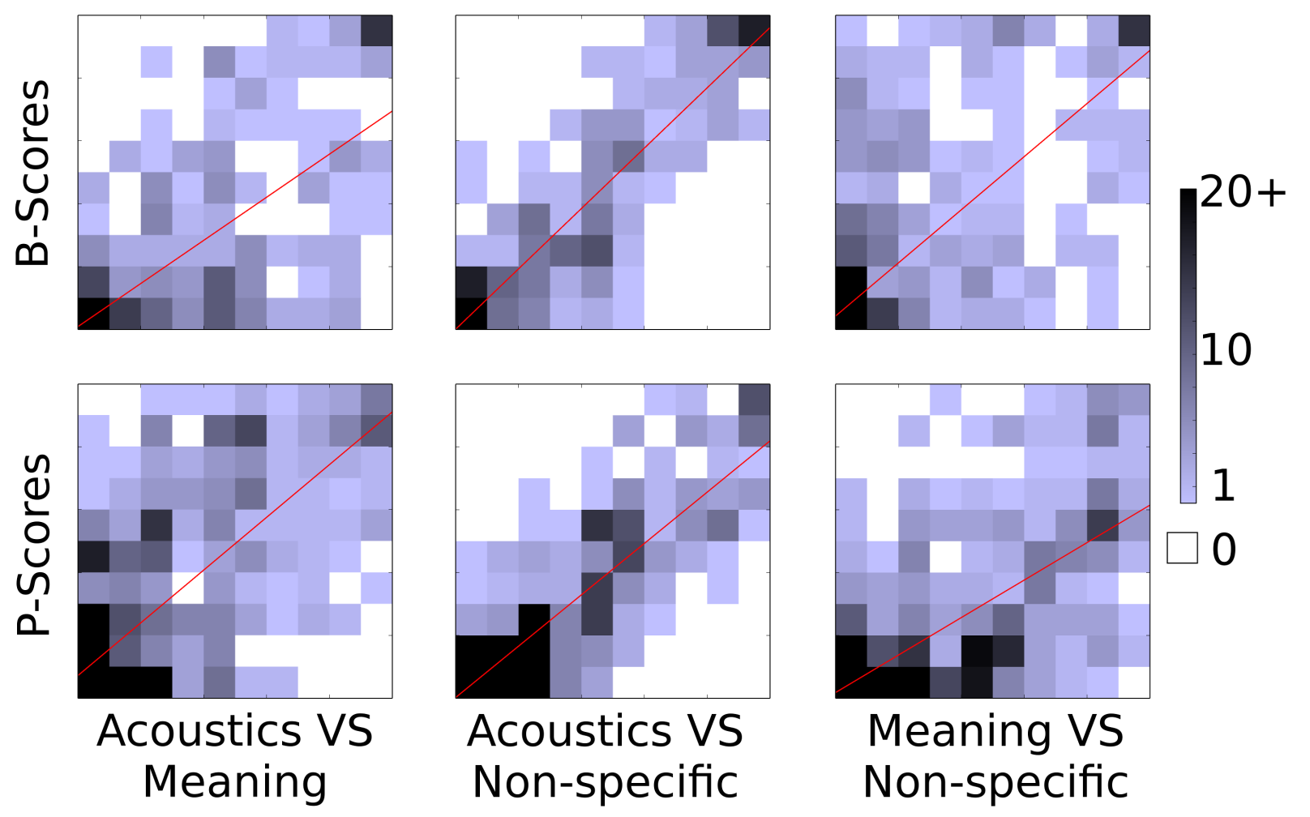
Correlation in scores
 | Acoustics vs Meaning | Acoustics vs Non-specific | Meaning vs Non-Specific
B-scores | 0.616 | 0.892 | 0.528
P-scores | 0.575 | 0.828 | 0.540
Data originally presented in Cole, Mahrt, and Hualde; Speech Prosody 2014

Slide 67
Take Away Message
Annotations gathered under the non-specific instructions correlate most strongly to annotations from the acoustic instructions

Slide 68
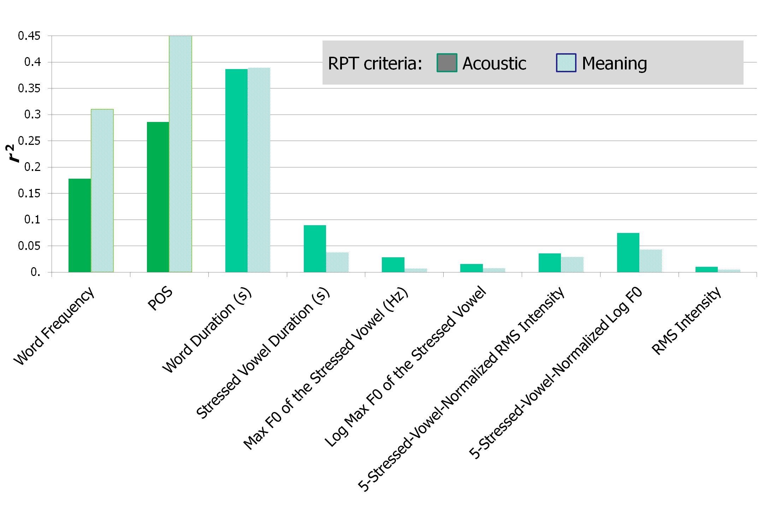
B/P-Scores and Prominence Cues
Data originally presented in Cole, Hualde, Mahrt, Eager, and Im; Lab Phon 2014

Slide 69
Take Away Message
Acoustic cues to prominence are better at predicting the p-scores from the acoustic instructions
Meaning-based cues (part-of-speech, word frequency) are better at predicting the p-scores from the meaning instructions
By changing the instructions, we are able to focus listeners to attend to particular information in the signal (acoustics or meaning-based cues)

Slide 70
Acknowledgements
Development of LMEDS was supported by NSF grant BCS 12-51343 to Jennifer Cole, José Hualde, and Caroline Smith.

Slide 71
LMEDS Support
Questions?
(Don’t forget the User Manual!)
Feature requests?
Bug reports?
Contact me! timmahrt@gmail.com

Slide 72
Dankeschön!
Questions?
Comments?

